Slide 1
Open a asian restaurant in Seattle

Slide 2
1. Introduction/Business Problem section
Korean food(Asian food) is getting more and more famous in Seattle lately. We can see the Korean dining is everywhere in United States, especially in Los angela. We are going to find the best location to open in Seattle and do more research about the business opportuntiy in Seattle.
This report will try to gather data about other restaurant localization, competitors and best localization.
ii) Problem
As the goal of this is to create a business plan in the end, we need to make sure data from api are correct. We also need to check that customer could be interested in this specific business.
In order to do so, a survey in Seattle and Los Angeles will be done in addition to data gathering. I’ll go in the cities and check at different hours if restaurants are working, if streets are full and so on, and what kind of restaurant works well. This survey will allow to validate the data analysis done here.

Slide 3
2. Data
I will change some data:
Country/City: United States Goal: Open a restaurant/little shop for workers in weekday and maybe saturday So, I will cross data from working days, and localisations.
I will use the following API:
Foursquare API: to find restaurant/venues Google API: reverse geolocalisation

Slide 4
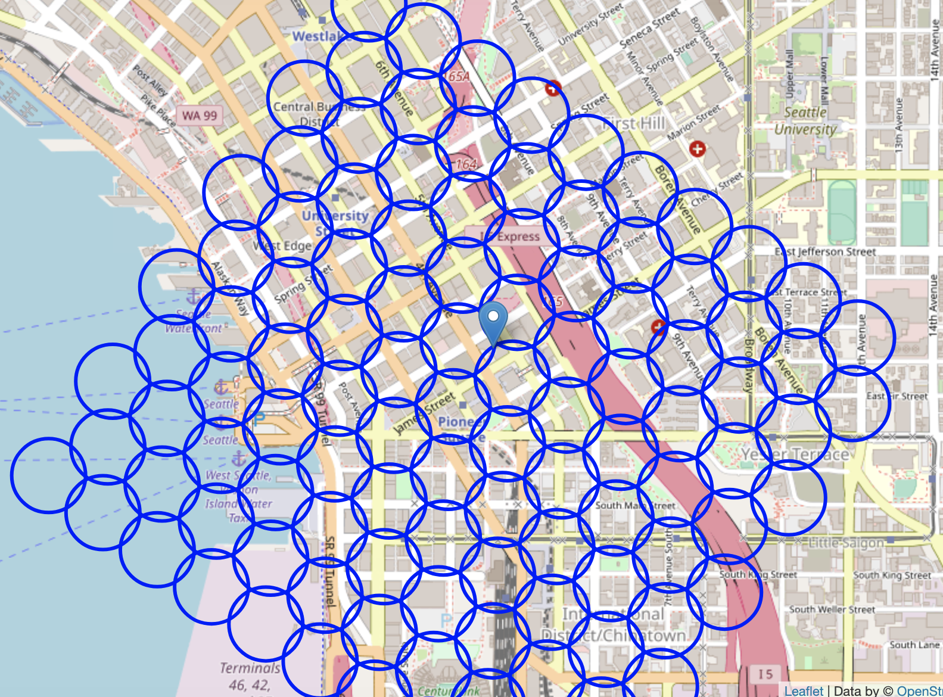

Slide 5
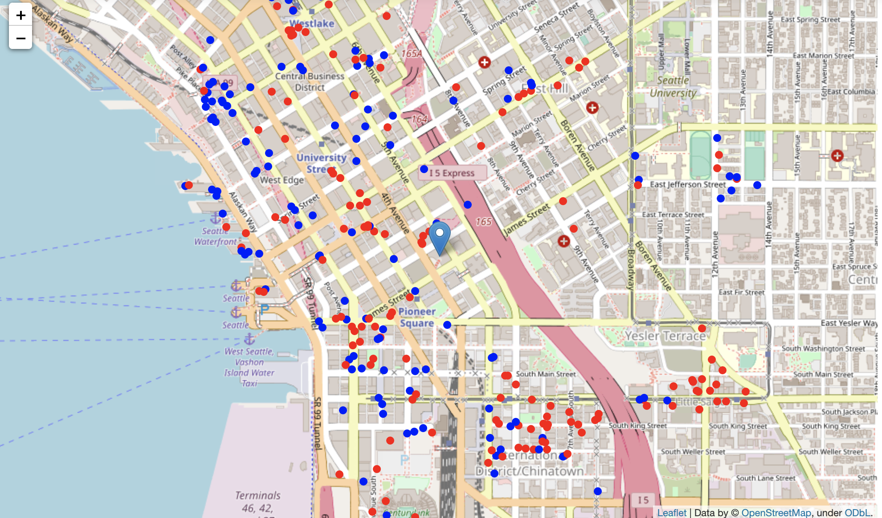
3. Methodology¶
Blue:non-asian restaurant
Red:Asian restaurant

Slide 6
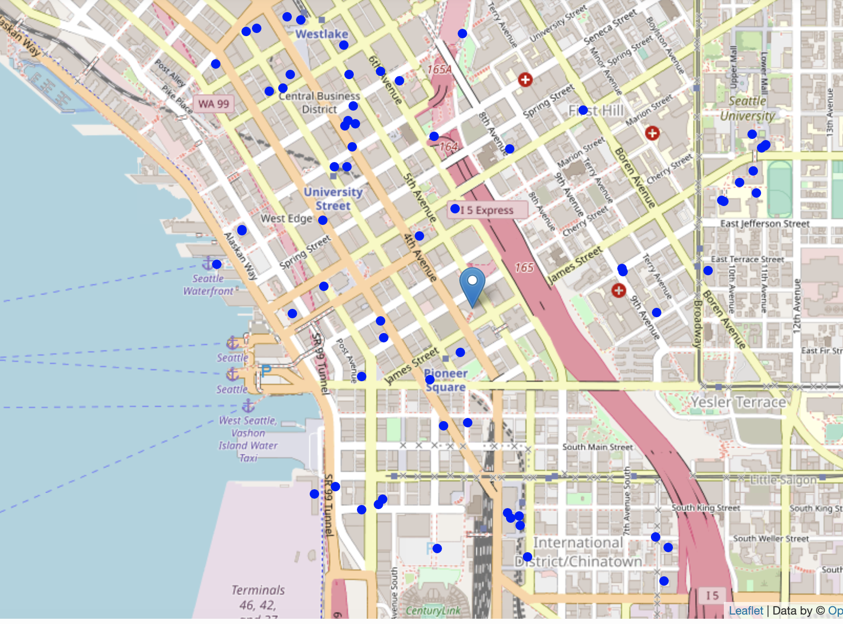
university

Slide 7
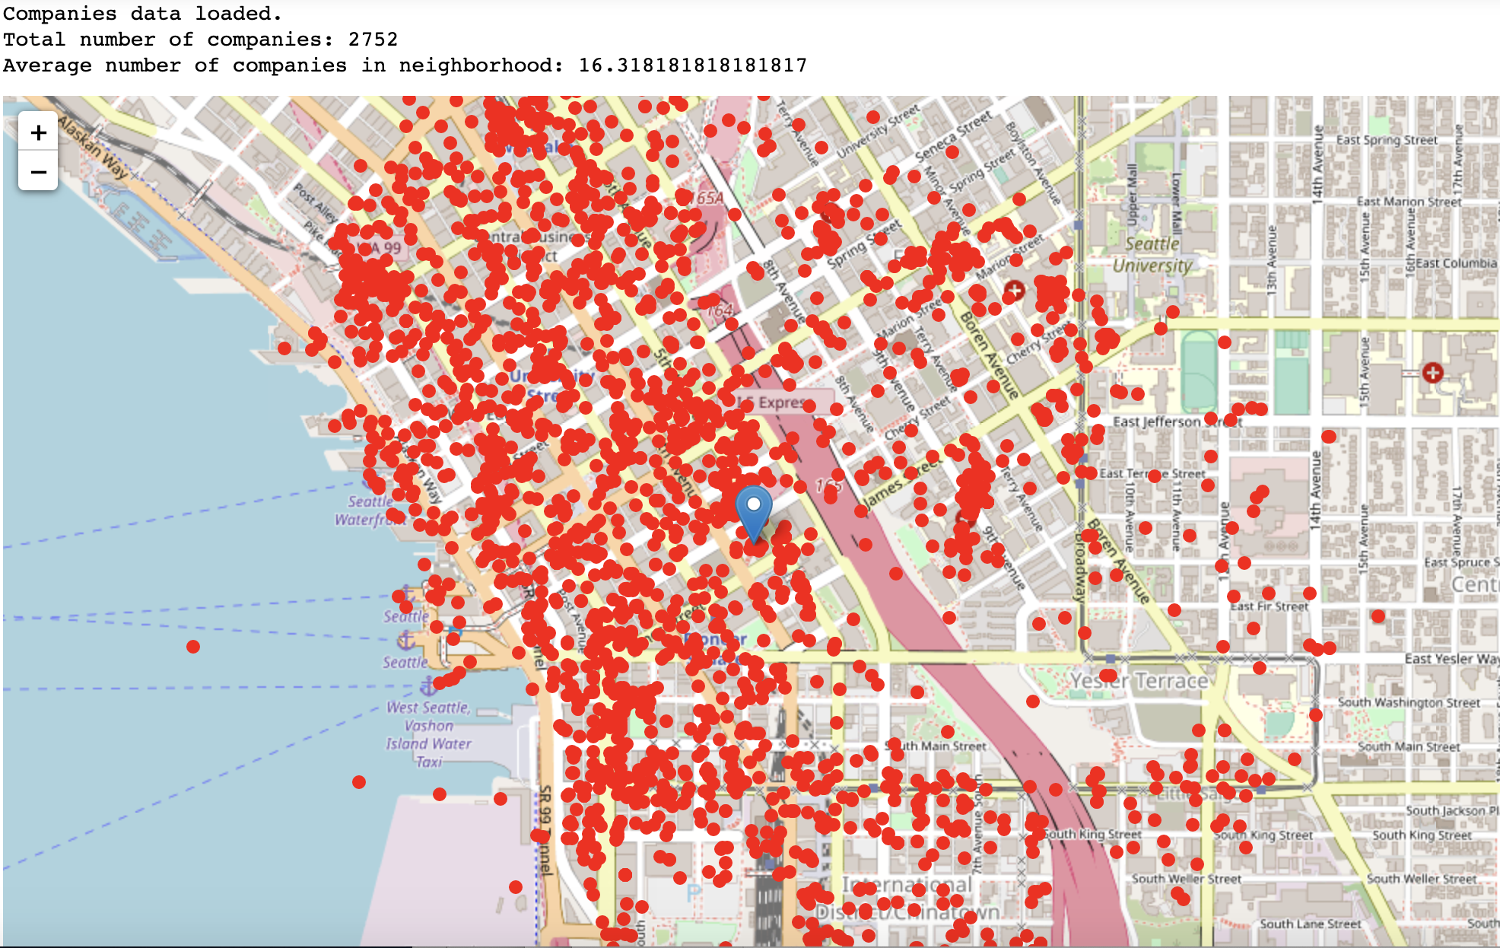

Slide 8
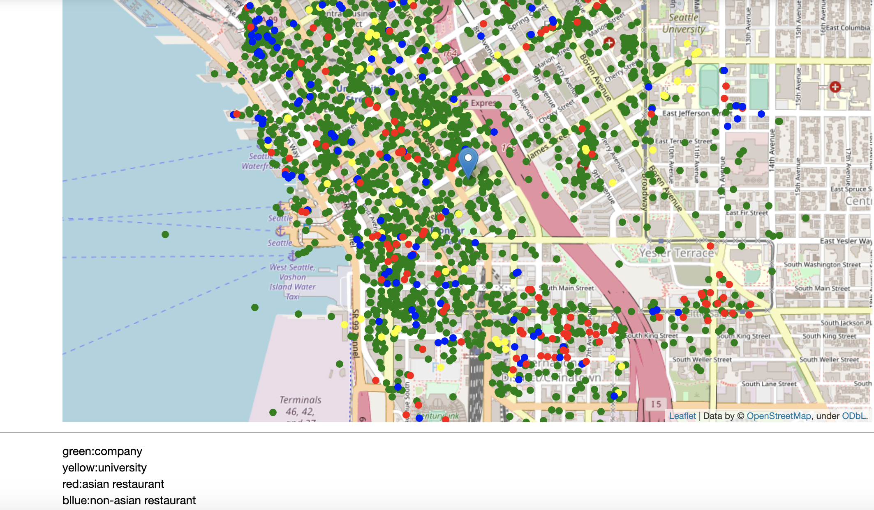

Slide 9
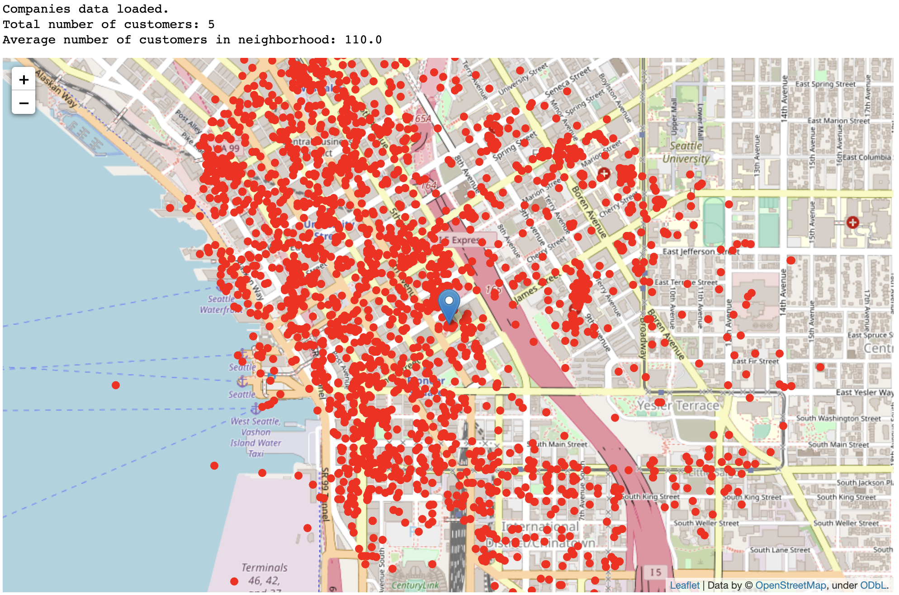

Slide 10
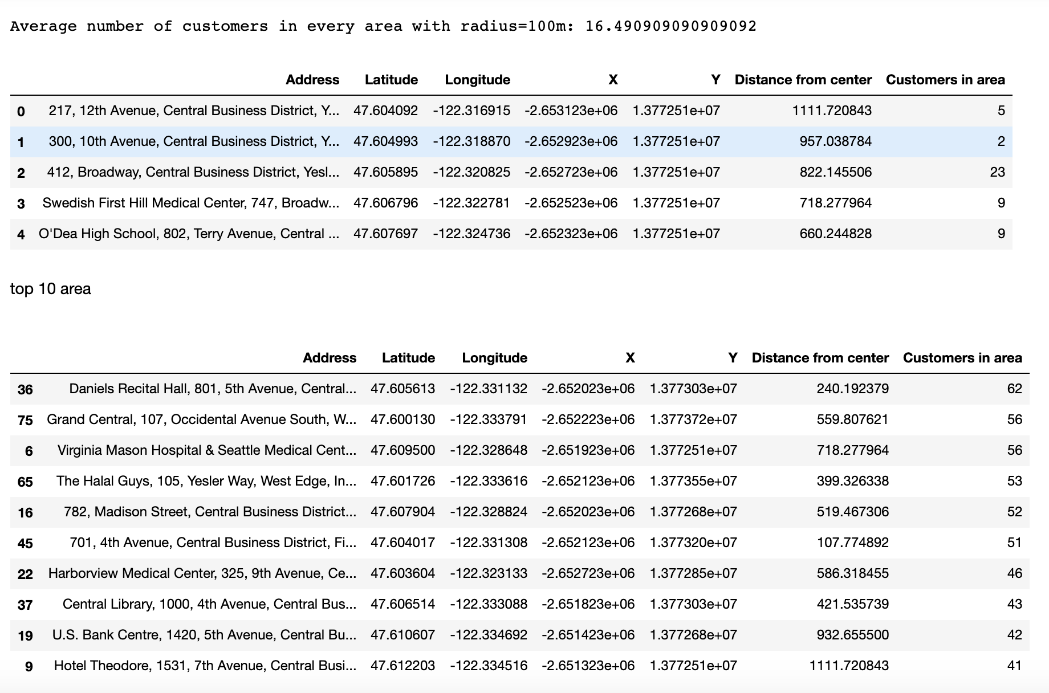

Slide 11
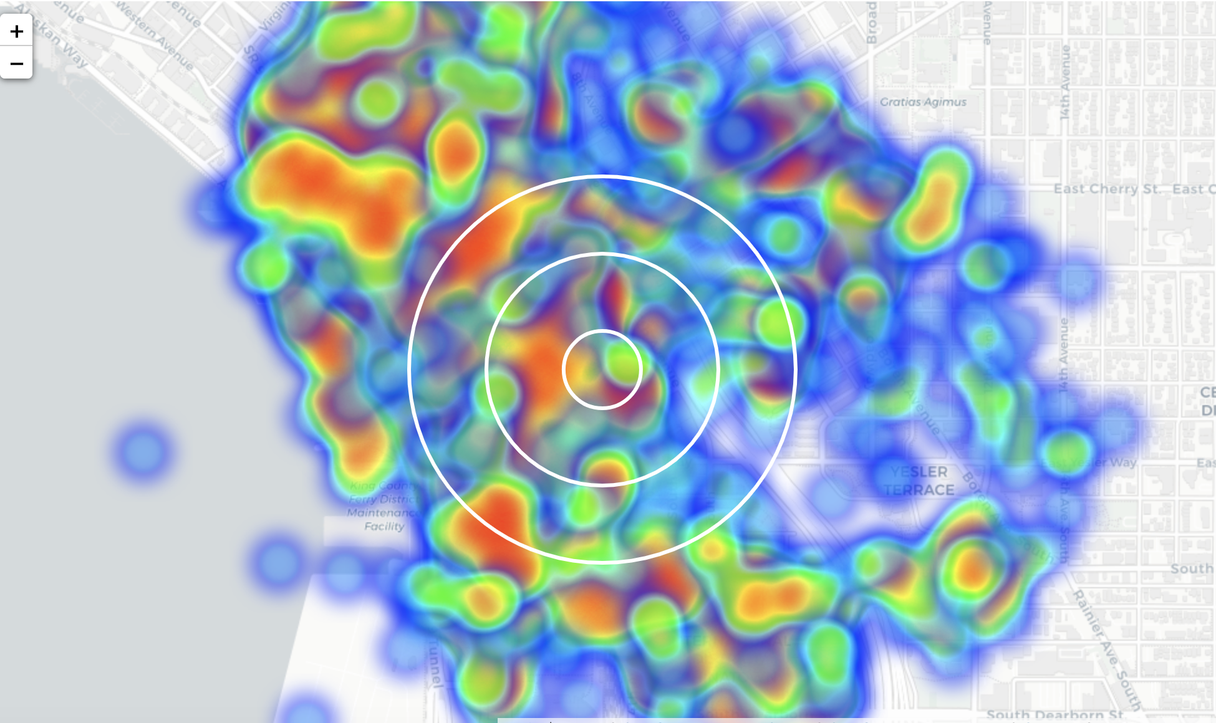
Customer heatmap

Slide 12
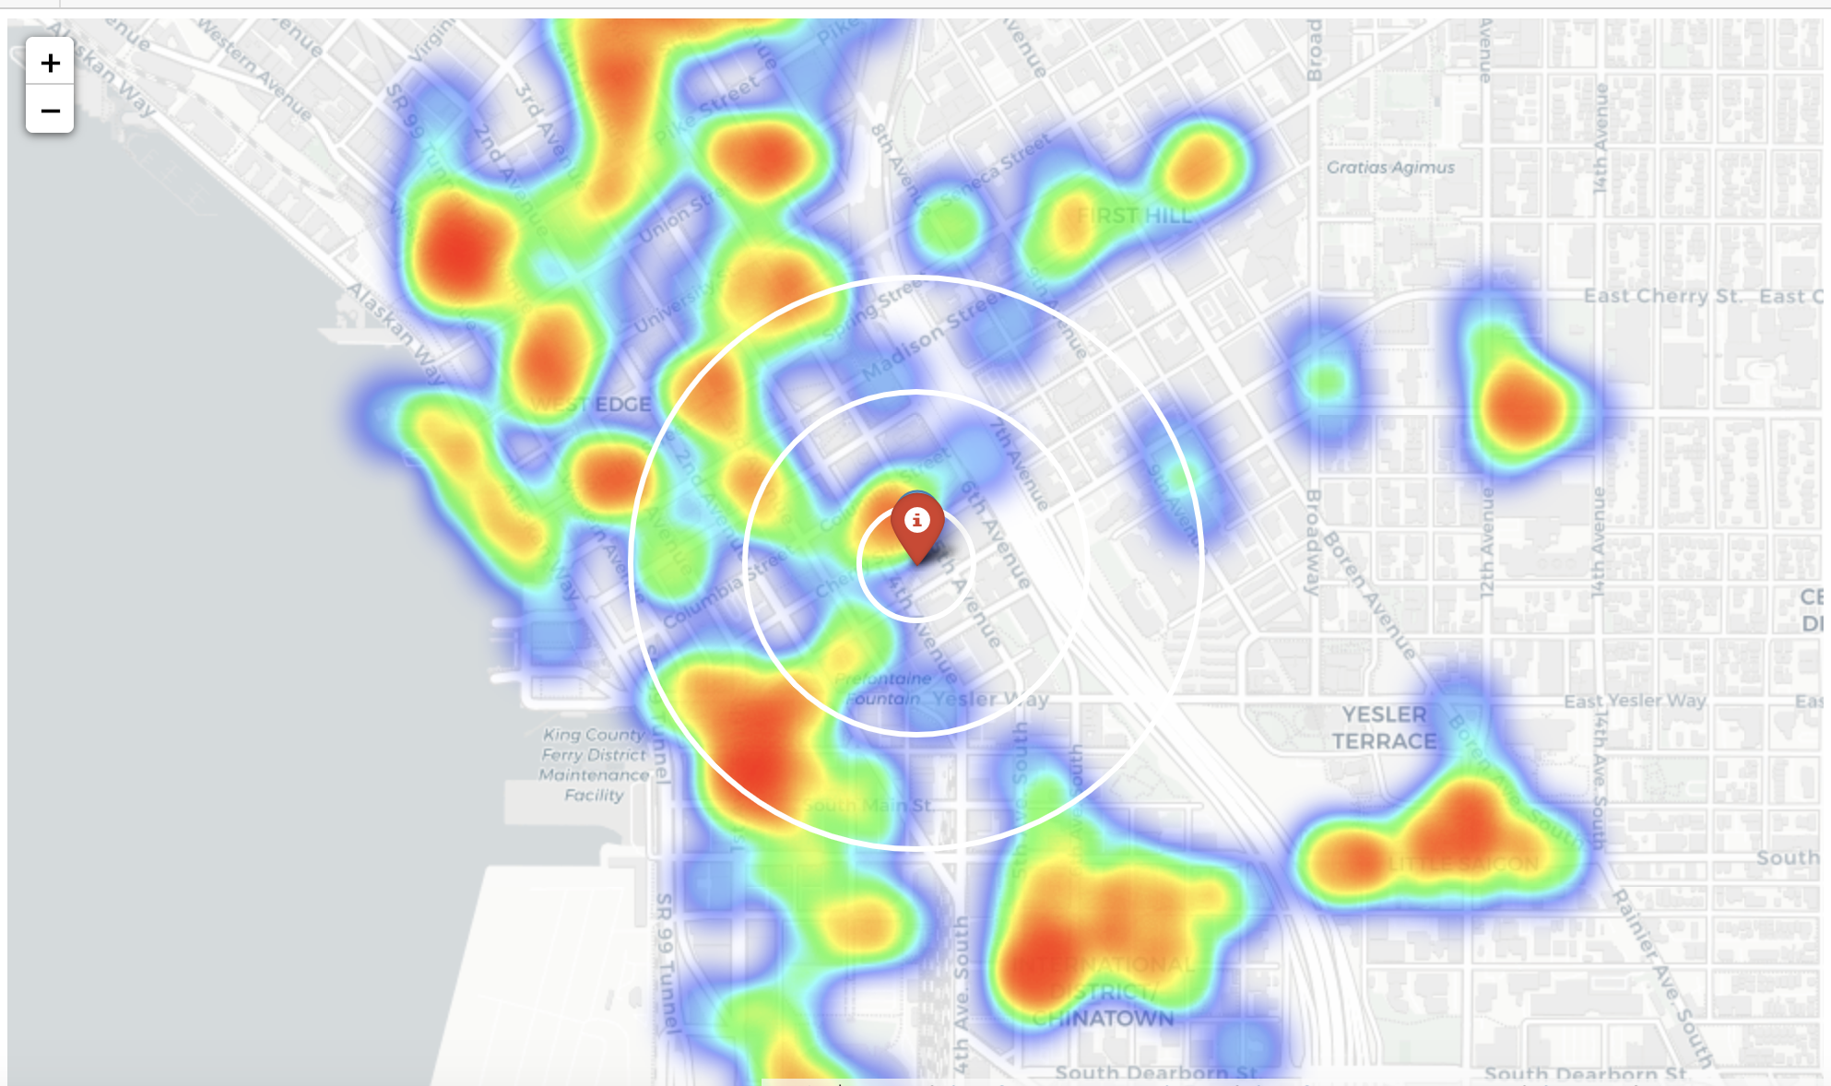

Slide 13
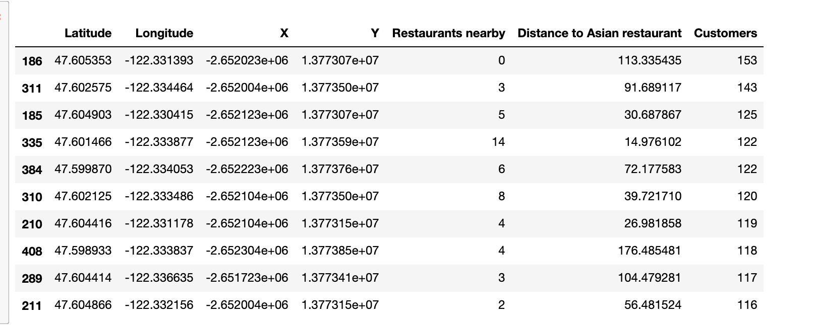
K-mean cluster

Slide 14
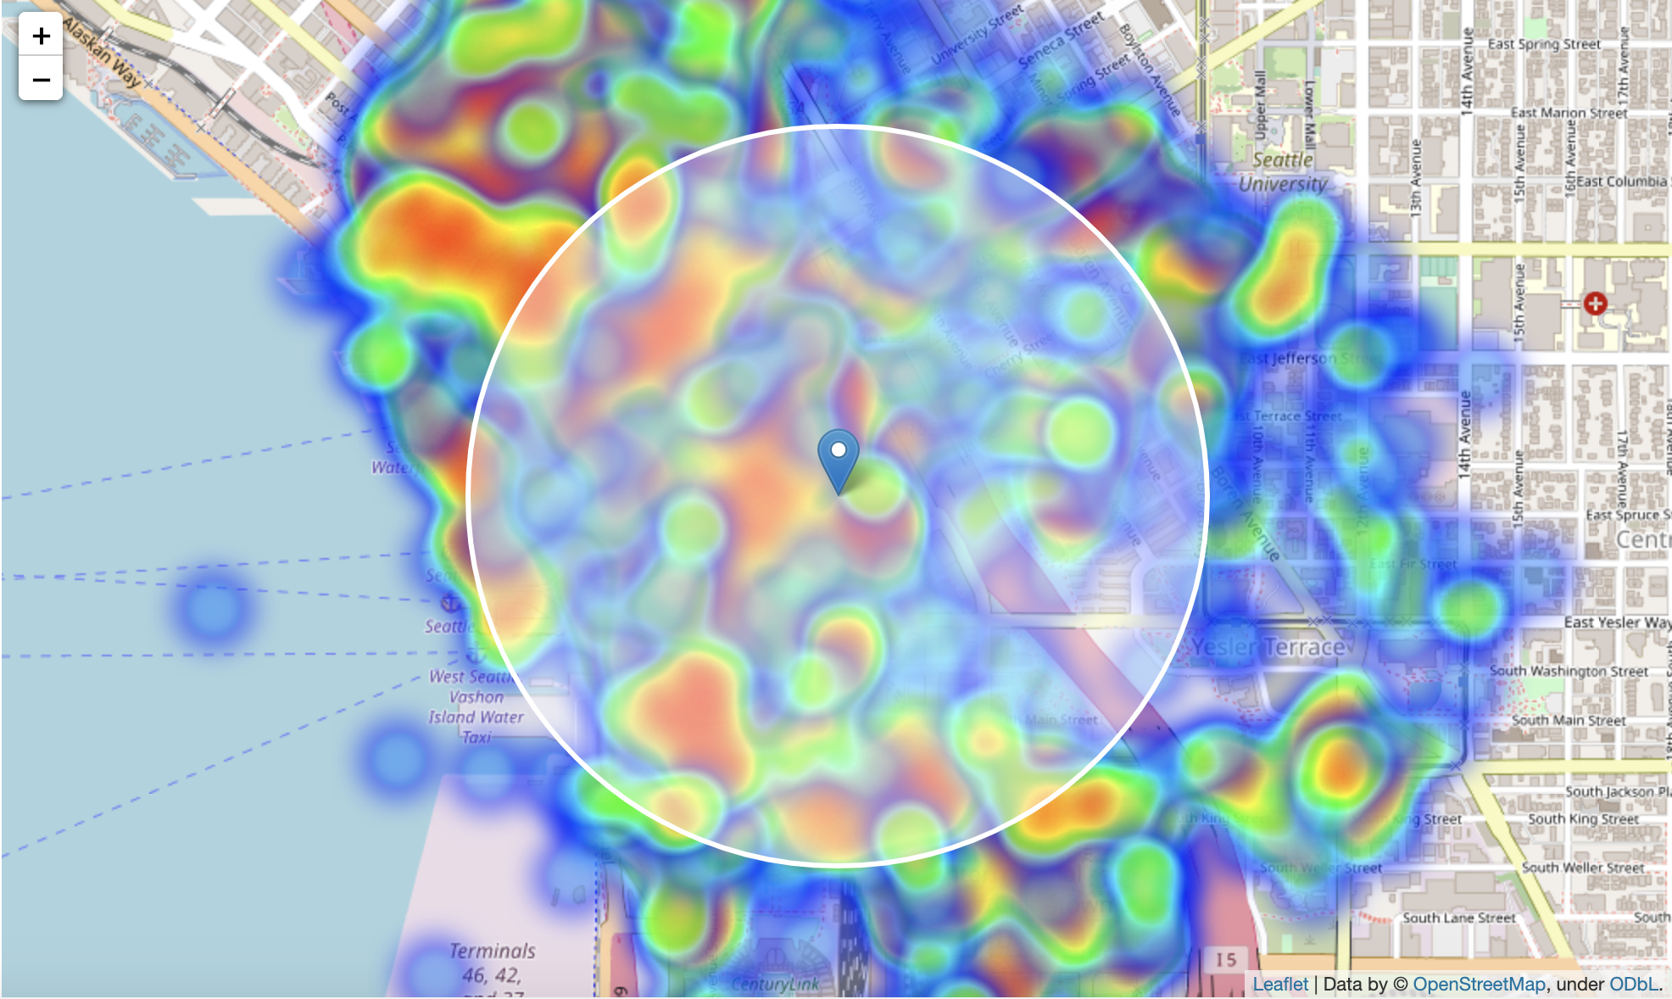

Slide 15
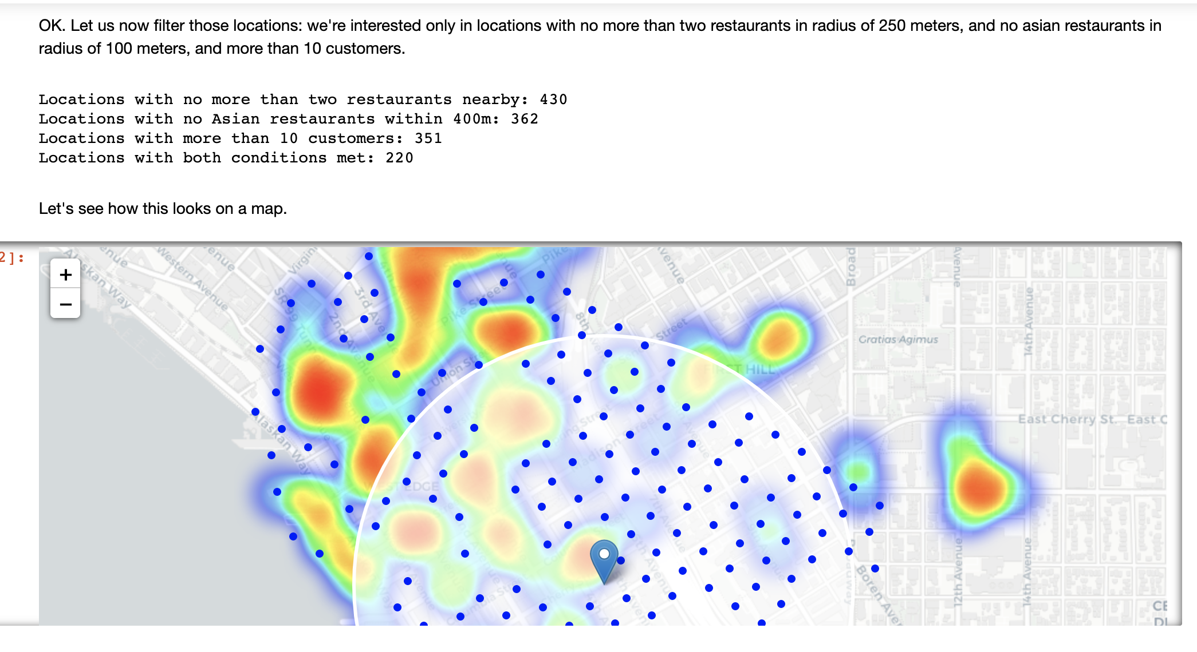

Slide 16
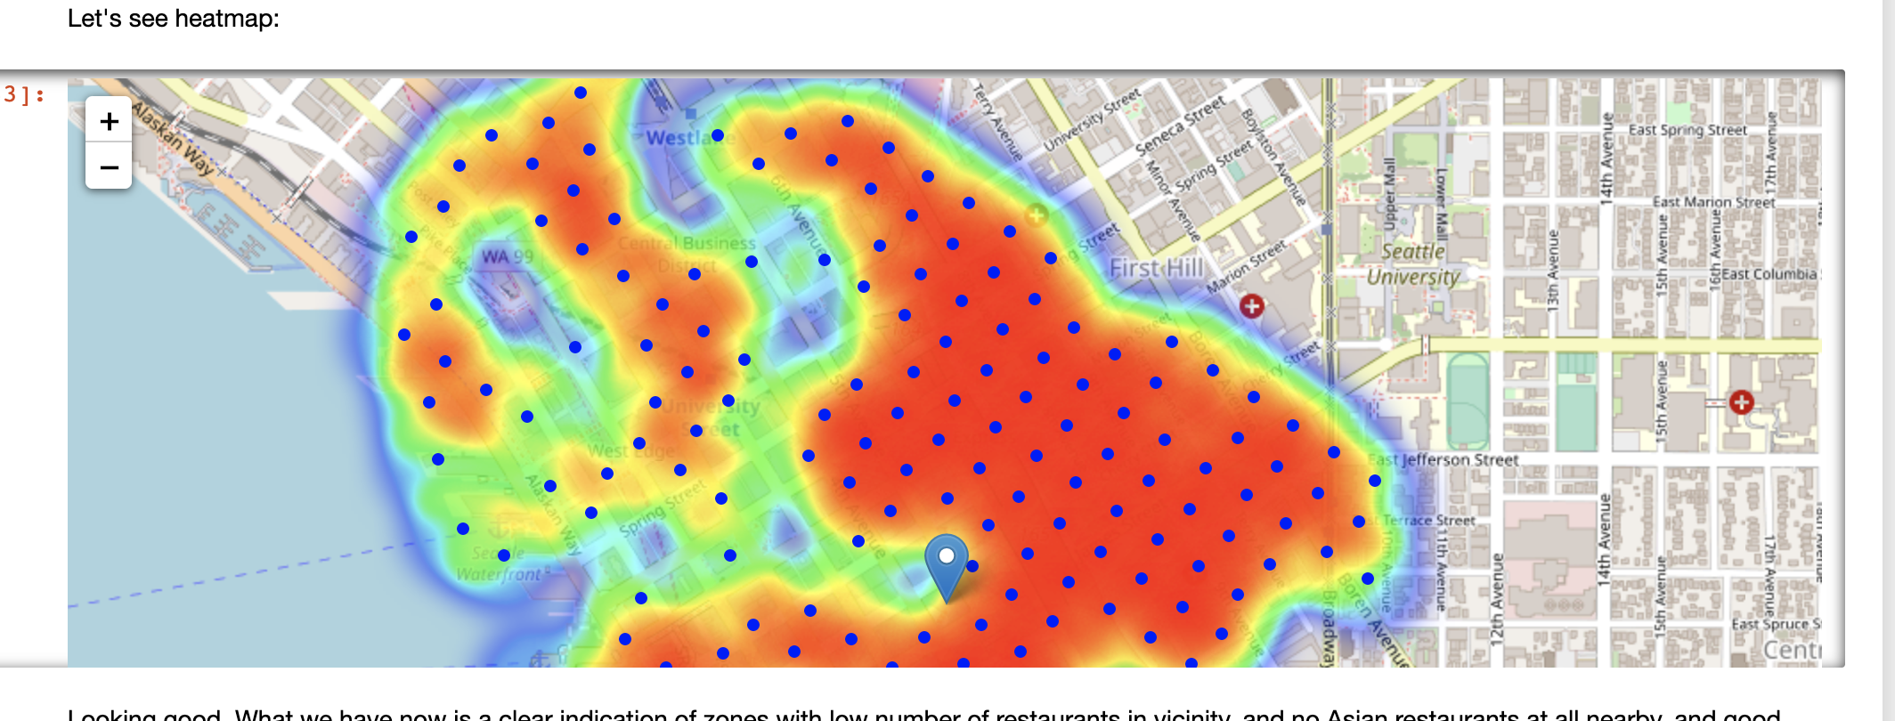

Slide 17
Best location cluster (green circle)

Slide 18
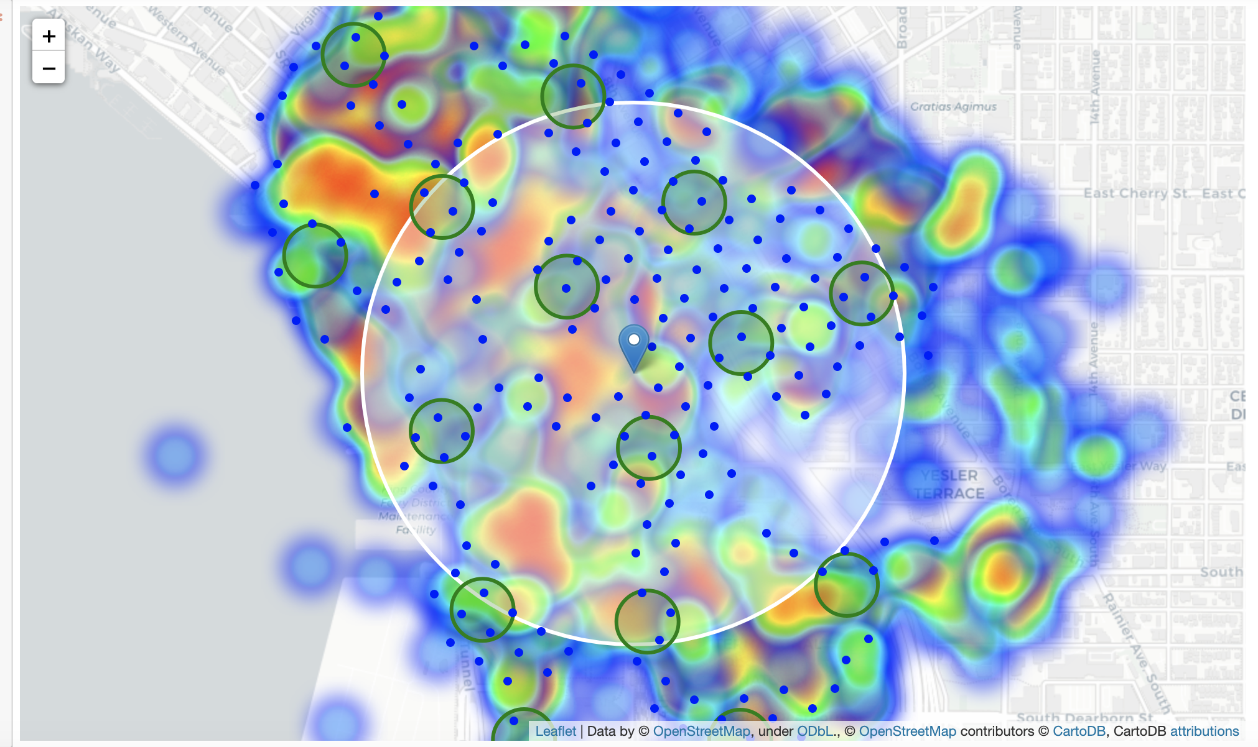

Slide 19
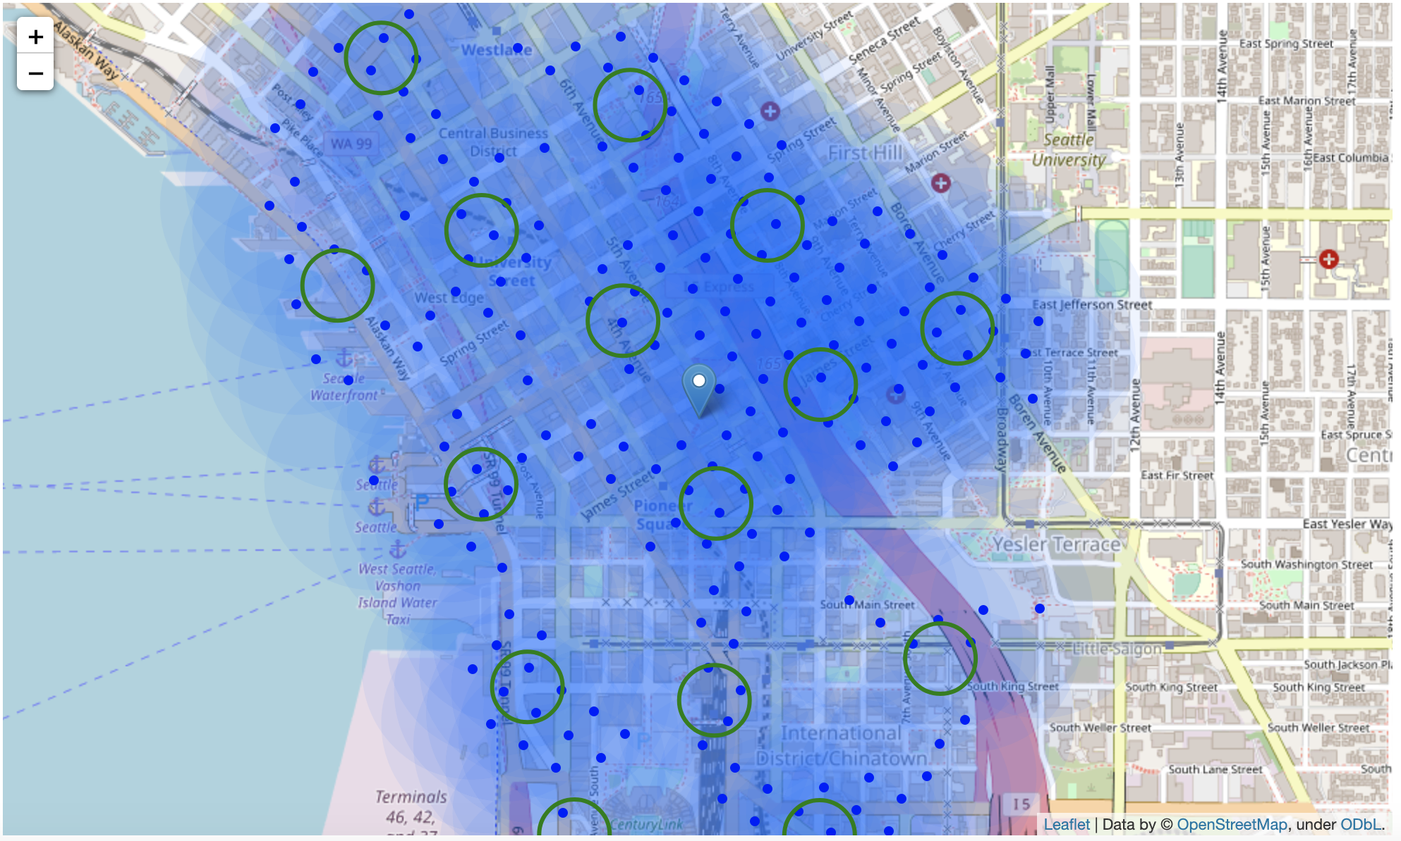

Slide 20
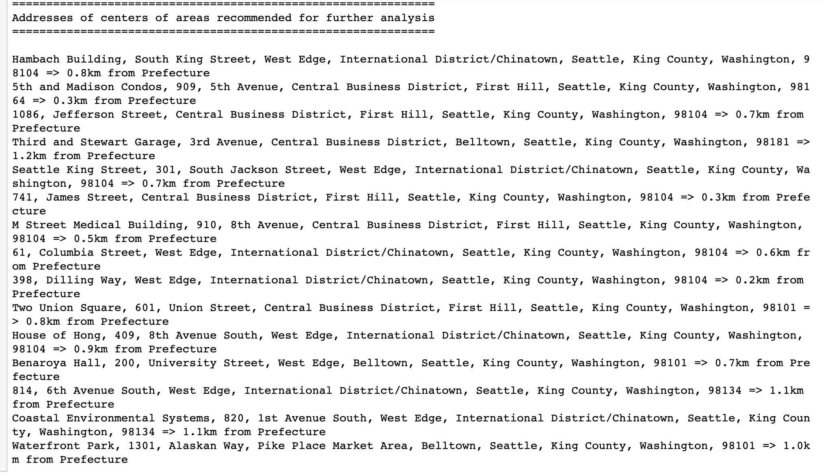

Slide 21
Thank you!

